Slide 1
Problems In File Processing approach
Data redundancy and inconsistency
Same information may be duplicated in several places.
All copies may not be updated properly
Difficulty in accessing data
May have to write a new application program to satisfy an unusual request.
E.g. find all customers with the same postal code.
Could generate this data manually, but a long job...
Data isolation
Data in different files.
Data in different formats.
Multiple users
Want concurrency for faster response time.
Need protection for concurrent updates.
E.g. two customers withdrawing funds from the same account at the same time. account has Rs. 500 in it, and they withdraw Rs. 100 and Rs. 50. The result could be Rs. 350, Rs.400 or Rs. 450 if no protection

Slide 2
Problems In File Processing approach
Security problems
Every user of the system should be able to access only the data they are permitted to see.
E.g. payroll people only handle employee records, and cannot see customer accounts; tellers only access account data and cannot see payroll data.
Difficult to enforce this with file processing programs.
Integrity problems
Data may be required to satisfy constraints.
E.g. no account balance below Rs 25.00.
Again, difficult to enforce or to change constraints with the file-processing approach.
These problems and others led to the development of database management system.

Slide 3
Data Abstraction
The major purpose of a database system is to provide users with an abstract view of the system.
The system hides certain details of how data is stored and maintained
Complexity is hidden from database users.
These are the levels of abstraction
A) Physical Level
B) Conceptual Level
C) View Level

Slide 4
Data abstraction cont..
A) Physical Level
Lowest level of abstraction.
How the data are stored.
E.g. index, B-tree, hashing
Complex low-level structures described in detail.
B) Conceptual Level
Next highest level of abstraction.
Describes what data are stored.
Describes the relationships among data.
Database administrator level.

Slide 5
Data Abstraction contd…
C) View Level
Highest level.
Describes part of the database for a particular group of users.
Can be many different views of a database.
E.g. tellers in a bank get a view of customer accounts, but not of payroll data.

Slide 6
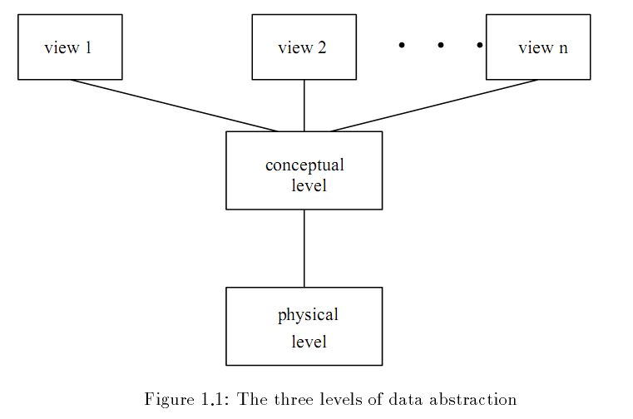

Slide 7
Data Modelling
It is the process of creating a representation of the structure of the database. The result of the process is a “data model”.
Data models are a collection of conceptual tools for describing data, data relationships, data semantics and data constraints
So a data model
Identifies what is to be stored in the database.
It also defines structure and relationship
It is the basis for all subsequent database development

Slide 8
Data Model cont..
There are different groups:
A) Object-based Logical Models.
Describe data at the conceptual and view levels.
Over 30 models including
Entity Relationship model (ER model)
Object Oriented model
Binary model
Semantic data model, etc.
B)Physical Data Models
Are used to describe data at the lowest level.
Very few models, e.g.
Unifying model.
Frame memory.
We will only cover ER Modelling
We will not cover physical models

Slide 9
E-R Model
The entity-relationship model is based on a perception of the world as consisting of a collection of basic objects entities and relationships among these objects.
An entity is a distinguishable object that exists.
Each entity has associated with it a set of attributes describing it. E.g. number and balance for an account entity.
A relationship is an association among several entities.
e.g. A cust acct relationship associates a customer with each account he or she has.
The set of all entities or relationships of the same type is called the entity set or relationship set.

Slide 10
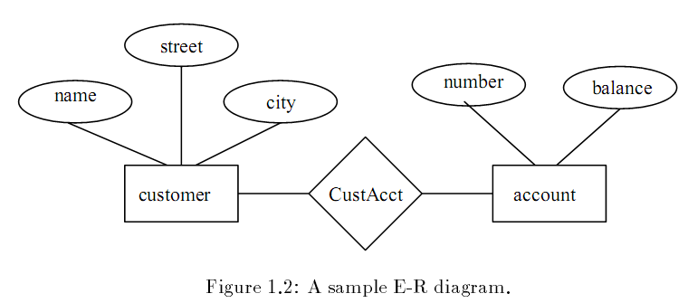
E-R Model contd..

Slide 11
Instances and Schemes
Database changes over time
The information in a database at a particular point in time is called an instance of the database.
The overall design of the database is called the database scheme.
Analogy with programming language:
Data type definition – scheme
Value of a variable – instance
There are several schemes, corresponding to levels of abstraction:
Physical scheme
Conceptual scheme

Slide 12
Data independence
The ability to allow users to take a logical view of the database which is independent of the way that the data is stored.
The ability to modify a scheme definition in one level without affecting a scheme definition in a higher level is called data independence.

